Slide 1




Mathematical Statistics
Projet 3 : Bayesian estimation and prediction of counts of plane accidents
Théo DECREUX
Anas RABHI HAKIM
Sarah LAUZERAL
Aurélie MERCADIE

Slide 2
Introduction
Overview & Motivation
Outline of the presentation
The objective of this project is to estimate the mean number of events in a given period of time from a data set of plane accidents dates.
To do that we are going to try several methods : the maximum likelihood and different Bayesian estimators.
We are also going to learn about modelling and simulation with the use of bootstrap.
Justification for the use of a Poisson distribution for modeling the number of plane accidents.
Determination of the Bayesian estimator derived from a gamma prior.
Estimation of the mean number of plane accidents per week, and per month by 3 different methods.
Plot of the density curves.
Parametric bootstrap approach.
Difference between the prior and posterior predictive distributions.

Slide 3
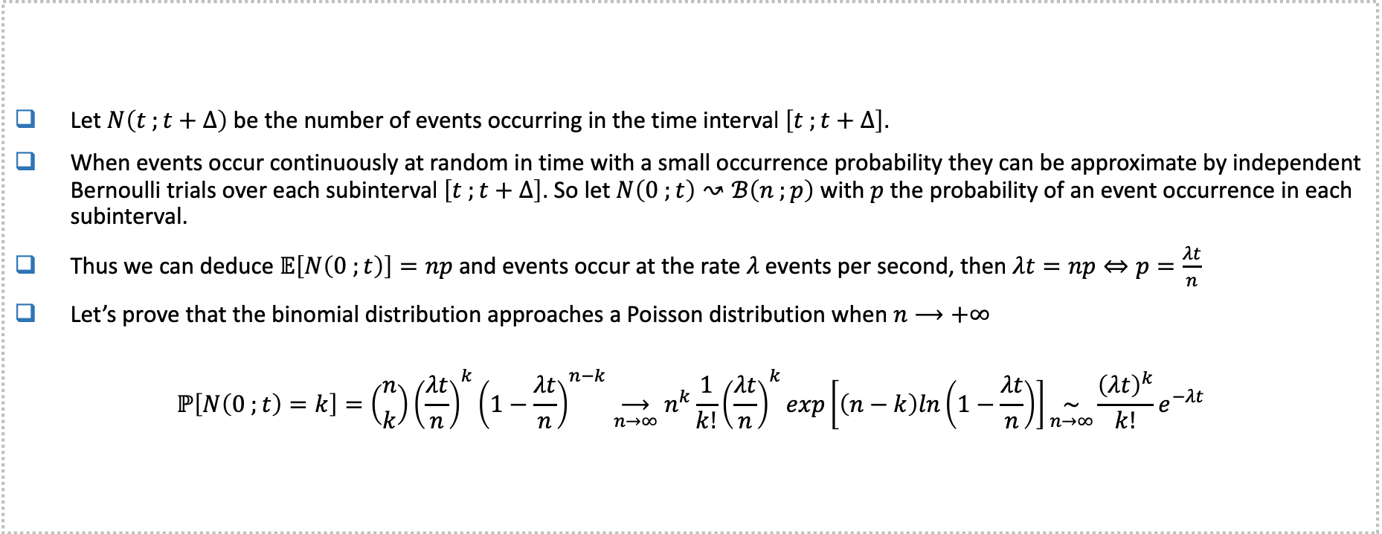
Poisson distribution for modeling the number of plane accidents
Let $N\left(t ;t+∆\right)$ be the number of events occurring in the time interval $\left[t ;t+∆\right]$.
When events occur continuously at random in time with a small occurrence probability they can be approximate by independent Bernoulli trials over each subinterval $\left[t ;t+∆\right]$. So let $N\left(0 ;t\right)↝ℬ\left(n ;p\right)$ with $p$ the probability of an event occurrence in each subinterval.
Thus we can deduce $𝔼\left[N\left(0 ;t\right)\right]=np$ and events occur at the rate $λ$ events per second, then $λt=np⇔p=\frac{λt}{n}$
Let’s prove that the binomial distribution approaches a Poisson distribution when $n⟶+∞$
$$ℙ\left[N\left(0 ;t\right)=k\right]=\left({n \atop k}\right){\left(\frac{λt}{n}\right)}^{k}{\left(1−\frac{λt}{n}\right)}^{n−k}\underset{n→∞}{⟶}n^{k}\frac{1}{k!}{\left(\frac{λt}{n}\right)}^{k}exp\left[\left(n−k\right)ln\left(1−\frac{λt}{n}\right)\right]\underset{n→∞}{\sim}\frac{{\left(λt\right)}^{k}}{k!}e^{−λt}$$

Slide 4
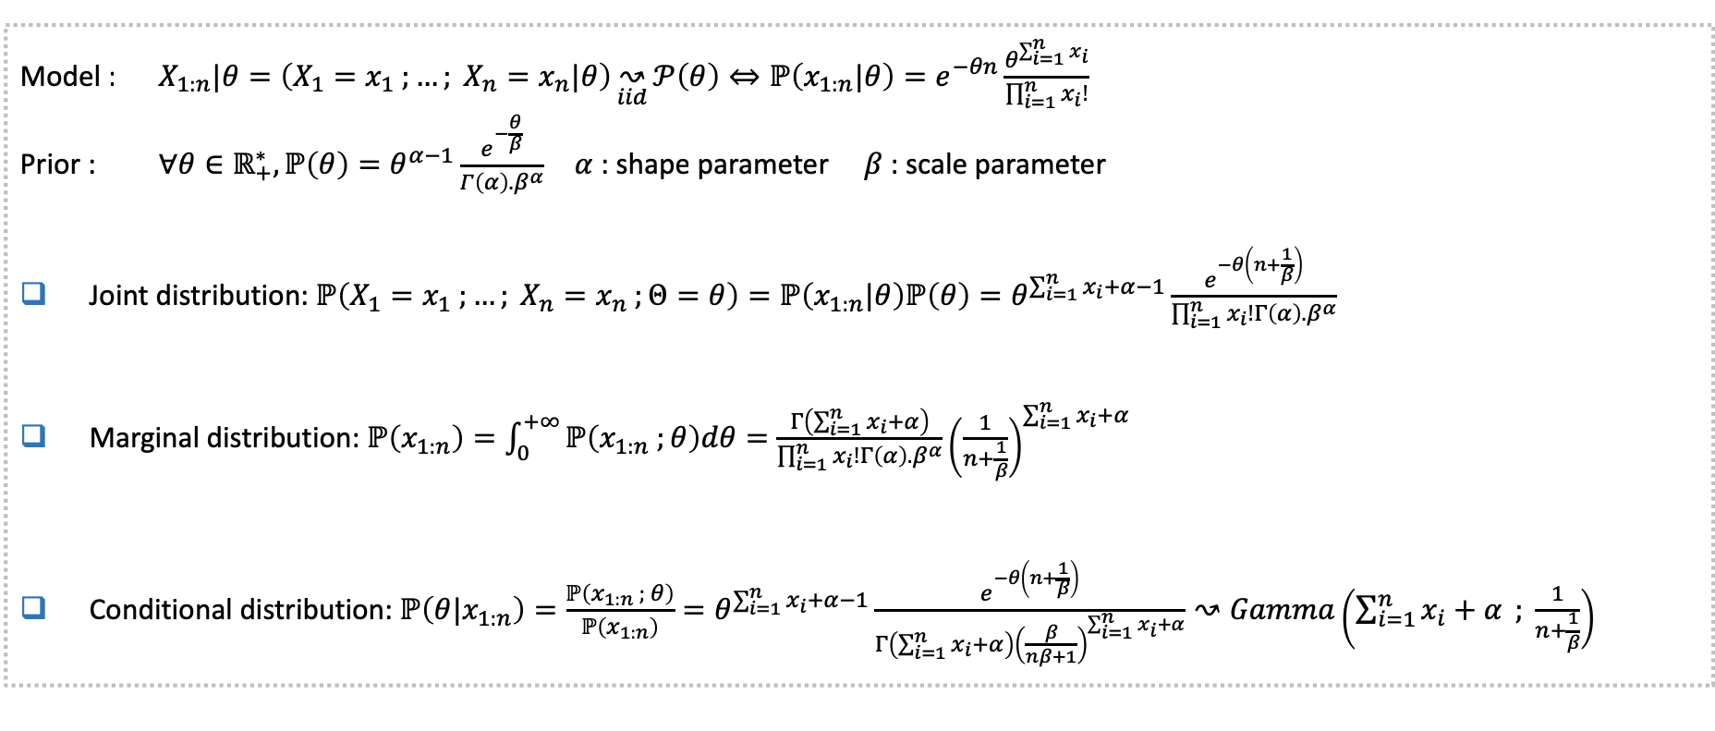
Determination of the Bayesian estimator derived from a gamma prior
Model : $X_{1:n}|θ=\left(X_{1}=x_{1} ;…; X_{n}=x_{n}|θ\right)\underset{iid}{↝}{𝒫\left(θ\right)}⇔ℙ\left(x_{1:n}|θ\right)=e^{−θn}\frac{θ^{\sum_{i=1}^{n}{x_{i}}}}{\prod_{i=1}^{n}{x_{i}!}}$
Prior : $∀θ∈ℝ_{+}^{∗}, ℙ\left(θ\right)=θ^{α−1}\frac{e^{−\frac{θ}{β}}}{Γ\left(α\right).β^{α}}$ $α$ : shape parameter $β$ : scale parameter
Joint distribution: $ℙ\left(X_{1}=x_{1} ;…; X_{n}=x_{n} ;Θ=θ\right)=ℙ\left(x_{1:n}|θ\right)ℙ\left(θ\right)=θ^{\sum_{i=1}^{n}{x_{i}}+α−1}\frac{e^{−θ\left(n+\frac{1}{β}\right)}}{\prod_{i=1}^{n}{x_{i}!}Γ\left(α\right).β^{α}}$
Marginal distribution: $ℙ\left(x_{1:n}\right)=\int_{0}^{+∞}{ℙ\left(x_{1:n} ;θ\right)dθ}=\frac{Γ\left(\sum_{i=1}^{n}{x_{i}}+α\right)}{\prod_{i=1}^{n}{x_{i}!}Γ\left(α\right).β^{α}}{\left(\frac{1}{n+\frac{1}{β}}\right)}^{\sum_{i=1}^{n}{x_{i}}+α}$
Conditional distribution: $ℙ\left(θ|x_{1:n}\right)=\frac{ℙ\left(x_{1:n} ; θ\right)}{ℙ\left(x_{1:n}\right)}=θ^{\sum_{i=1}^{n}{x_{i}}+α−1}\frac{e^{−θ\left(n+\frac{1}{β}\right)}}{Γ\left(\sum_{i=1}^{n}{x_{i}}+α\right){\left(\frac{β}{nβ+1}\right)}^{\sum_{i=1}^{n}{x_{i}}+α}}↝Gamma\left(\sum_{i=1}^{n}{x_{i}+α} ; \frac{1}{n+\frac{1}{β}}\right)$

Slide 5
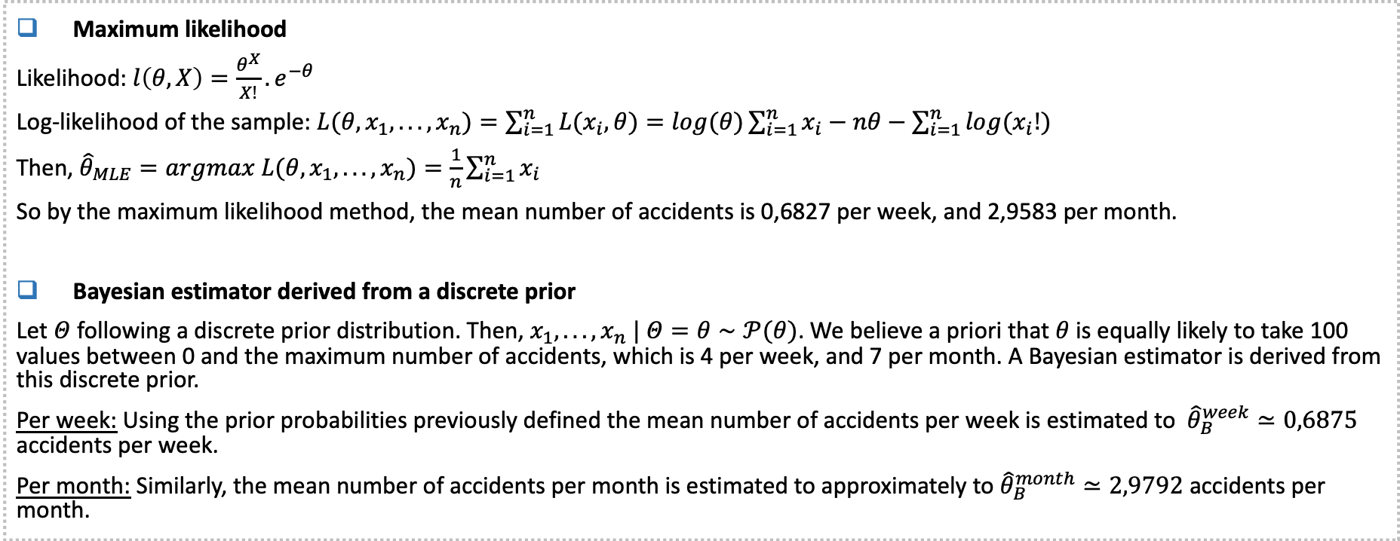
Estimation of the mean number of plane accidents (1/2)
Maximum likelihood
Likelihood: $l\left(θ, X\right)=\frac{θ^{X}}{X!}.e^{−θ}$
Log-likelihood of the sample: $L(θ, x_{1}, ..., x_{n})=\sum_{i=1}^{n}{L(x_{i},θ)}=log(θ)\sum_{i=1}^{n}{x_{i}}−nθ−\sum_{i=1}^{n}{log(x_{i}!)}$
Then, ${\hat{θ}}_{MLE}=argmax L(θ, x_{1}, ..., x_{n})=\frac{1}{n}\sum_{i=1}^{n}{x_{i}}$
So by the maximum likelihood method, the mean number of accidents is 0,6827 per week, and 2,9583 per month.
Bayesian estimator derived from a discrete prior
Let $Θ$ following a discrete prior distribution. Then, $x_{1}, ..., x_{n} | Θ=θ∼𝒫(θ)$. We believe a priori that $θ$ is equally likely to take 100 values between 0 and the maximum number of accidents, which is 4 per week, and 7 per month. A Bayesian estimator is derived from this discrete prior.
Per week: Using the prior probabilities previously defined the mean number of accidents per week is estimated to ${\hat{θ}}_{B}^{week}≃0,6875$ accidents per week.
Per month: Similarly, the mean number of accidents per month is estimated to approximately to ${\hat{θ}}_{B}^{month}≃2,9792$ accidents per month.

Slide 6
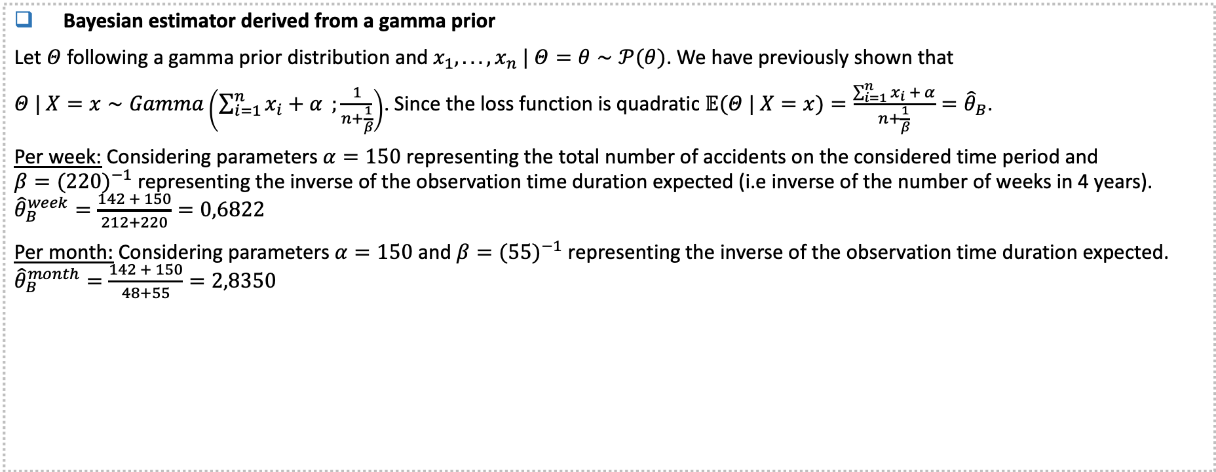
Estimation of the mean number of plane accidents (2/2)
Bayesian estimator derived from a gamma prior
Let $Θ$ following a gamma prior distribution and $x_{1}, ..., x_{n} | Θ=θ∼𝒫(θ)$. We have previously shown that
$Θ | X=x∼Gamma\left(\sum_{i=1}^{n}{x_{i}+α };\frac{1}{n+\frac{1}{β}}\right)$. Since the loss function is quadratic $𝔼(Θ | X=x)=\frac{\sum_{i=1}^{n}{x_{i} + α}}{n+\frac{1}{β}}={\hat{θ}}_{B}$.
Per week: Considering parameters $α=150$ representing the total number of accidents on the considered time period and $β={(220)}^{−1}$ representing the inverse of the observation time duration expected (i.e inverse of the number of weeks in 4 years). ${\hat{θ}}_{B}^{week}=\frac{142 + 150}{212+220}=0,6822$
Per month: Considering parameters $α=150$ and $β={(55)}^{−1}$ representing the inverse of the observation time duration expected. ${\hat{θ}}_{B}^{month}=\frac{142 + 150}{48+55}=2,8350$
 | Per week |  |  | Per month
 | MLE | Uniform prior | Gamma prior | MLE | Uniform prior | Gamma prior
Estimators | 0,6827 | 0.6875 | 0,6822 | 2,9583 | 2,9792 | 2,8350

Slide 7
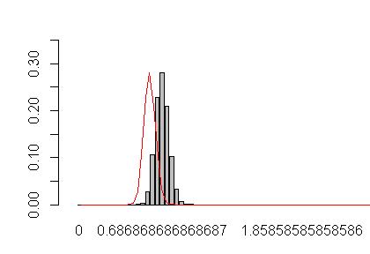
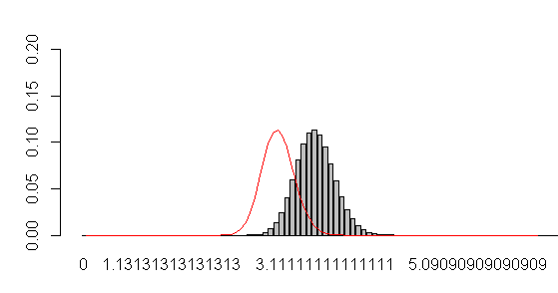
Density curves : a posteriori density of corresponding to the discrete uniform
Per week
Per month
A posteriori density of derived from a uniform prior
A posteriori density of derived from a uniform prior
We approximated the discrete uniform distribution by a continuous density function to be able to compare it with the a priori gamma density.

Slide 8
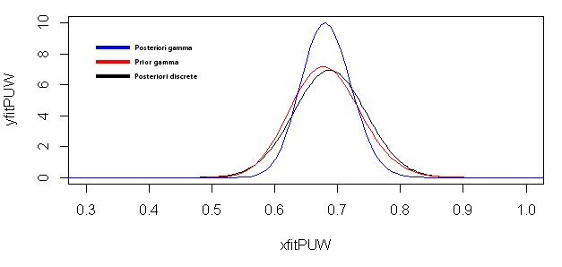
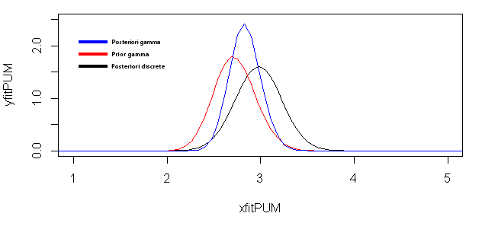

Density curves : prior & posterior density of corresponding to the gamma
Per week
Per month
The posteriori gamma distribution is more accurate than the prior, even the uniform distribution. The gamma posteriori it's continuous so the probability is going to be more accurate than the uniform posteriori which, in this case as we can see it's close to the gamma posteriori because of the set of $θ$ (100 close values between 0 and 4).
In this case the difference between the 3 densities it’s more noticeable, because of the set of values (100 values between 0 and 7), it makes the uniform be less accurate.

Slide 9
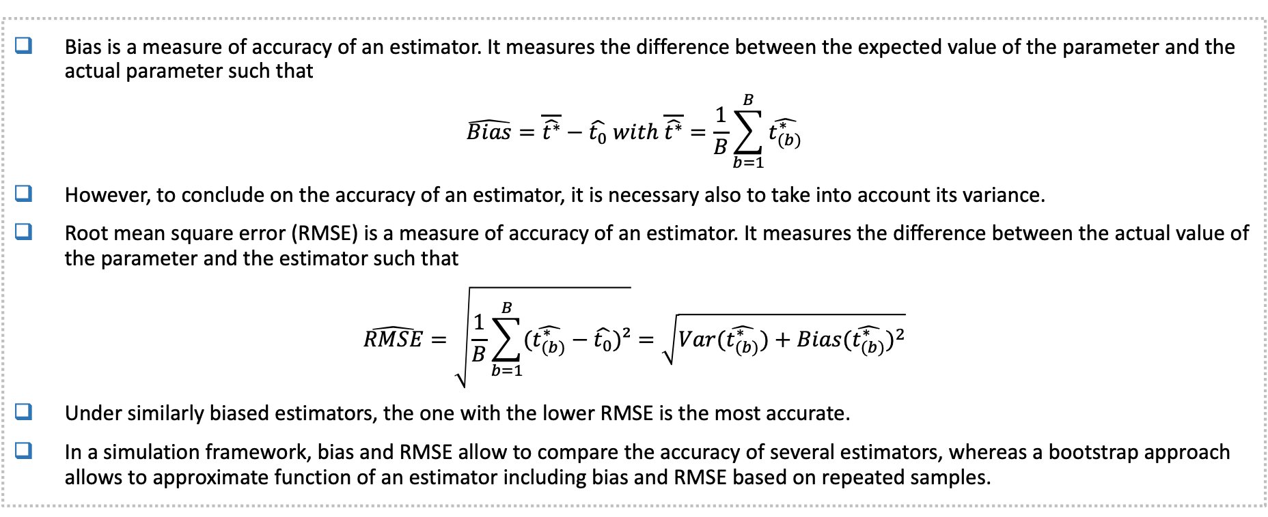
Data-based simulation approach – bootstrap (1/3)
Bias is a measure of accuracy of an estimator. It measures the difference between the expected value of the parameter and the actual parameter such that
$$\hat{Bias}=\overline{\hat{t^{∗}}}−\hat{t_{0}} with \overline{\hat{t^{∗}}}=\frac{1}{B}\sum_{b=1}^{B}{\hat{t_{(b)}^{∗}}}$$
However, to conclude on the accuracy of an estimator, it is necessary also to take into account its variance.
Root mean square error (RMSE) is a measure of accuracy of an estimator. It measures the difference between the actual value of the parameter and the estimator such that
$$\hat{RMSE}=\sqrt{\frac{1}{B}\sum_{b=1}^{B}{(\hat{t_{(b)}^{∗}}−\hat{t_{0}})²}}=\sqrt{Var(\hat{t_{(b)}^{∗}})+{Bias(\hat{t_{(b)}^{∗}})}^{2}}$$
Under similarly biased estimators, the one with the lower RMSE is the most accurate.
In a simulation framework, bias and RMSE allow to compare the accuracy of several estimators, whereas a bootstrap approach allows to approximate function of an estimator including bias and RMSE based on repeated samples.

Slide 10
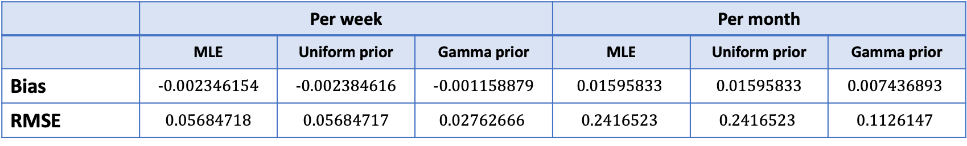
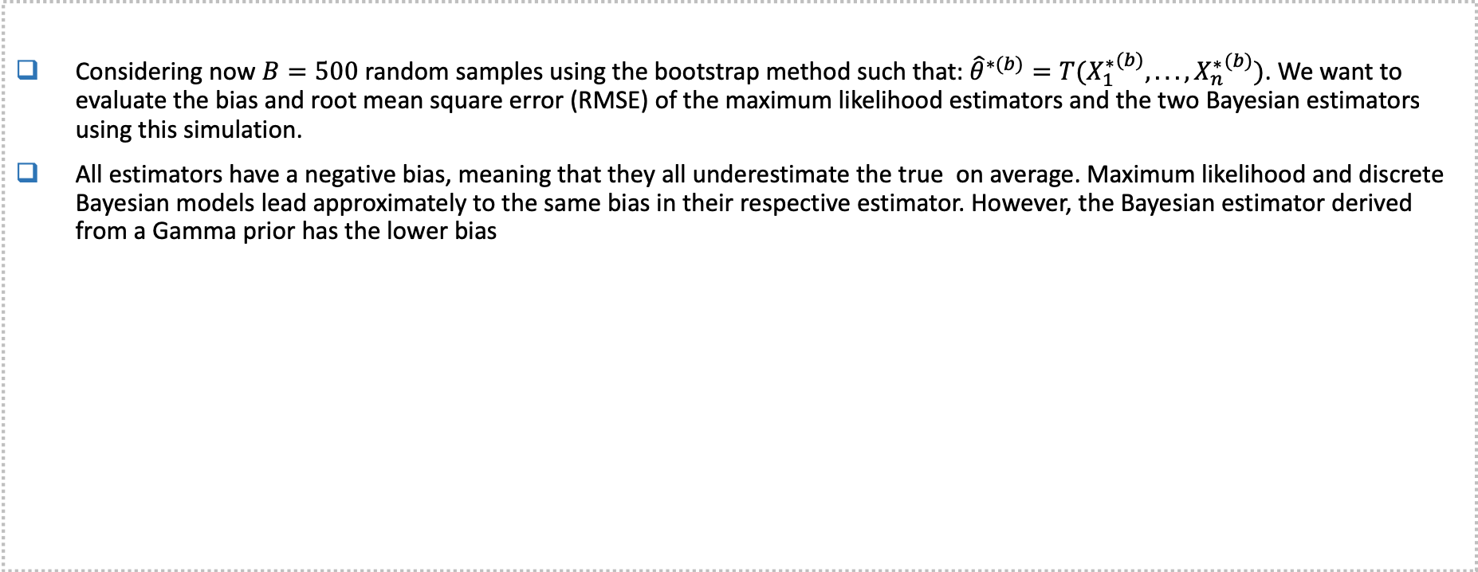
Data-based simulation approach – bootstrap (2/3)
Considering now $B=500$ random samples using the bootstrap method such that: ${\hat{θ}}^{∗(b)}=T({X_{1}^{∗}}^{(b)}, ... , {X_{n}^{∗}}^{(b)})$. We want to evaluate the bias and root mean square error (RMSE) of the maximum likelihood estimators and the two Bayesian estimators using this simulation.
All estimators have a negative bias, meaning that they all underestimate the true on average. Maximum likelihood and discrete Bayesian models lead approximately to the same bias in their respective estimator. However, the Bayesian estimator derived from a Gamma prior has the lower bias
 | Per week |  |  | Per month
 | MLE | Uniform prior | Gamma prior | MLE | Uniform prior | Gamma prior
Bias | -0.002346154 | -0.002384616 | -0.001158879 | $$\text{0.01595833}$$ | 0.01595833 | $$\text{0.007436893}$$
RMSE | 0.05684718 | 0.05684717 | $$\text{0.02762666}$$ | $$\text{0.2416523}$$ | $$\text{0.2416523}$$ | $$\text{0.1126147}$$

Slide 11
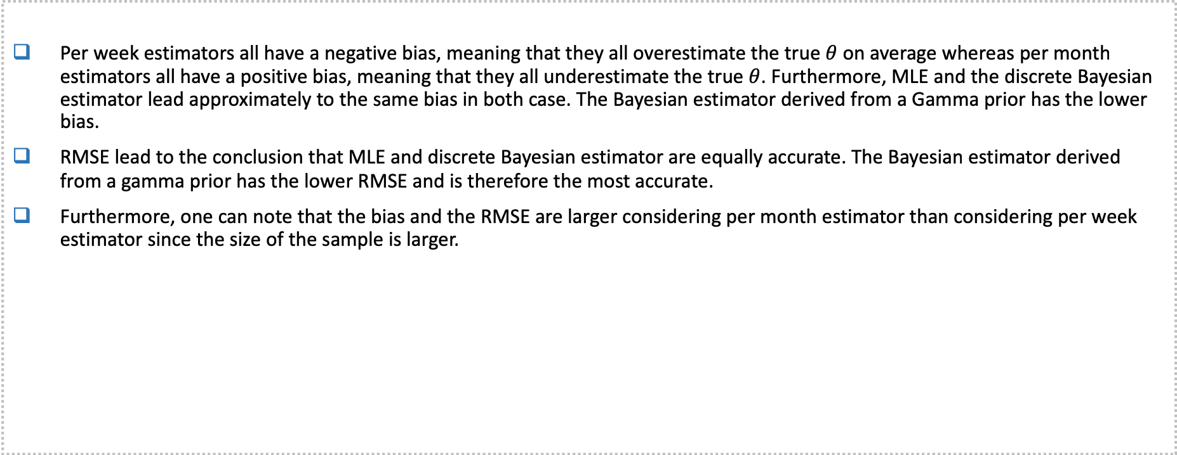
Data-based simulation approach – bootstrap (3/3)
Per week estimators all have a negative bias, meaning that they all overestimate the true $θ$ on average whereas per month estimators all have a positive bias, meaning that they all underestimate the true $θ$. Furthermore, MLE and the discrete Bayesian estimator lead approximately to the same bias in both case. The Bayesian estimator derived from a Gamma prior has the lower bias.
RMSE lead to the conclusion that MLE and discrete Bayesian estimator are equally accurate. The Bayesian estimator derived from a gamma prior has the lower RMSE and is therefore the most accurate.
Furthermore, one can note that the bias and the RMSE are larger considering per month estimator than considering per week estimator since the size of the sample is larger.
 | Per week |  |  | Per month
 | MLE | Uniform prior | Gamma prior | MLE | Uniform prior | Gamma prior
Bias | -0.002346154 | -0.002384616 | -0.001158879 | $$\text{0.01595833}$$ | 0.01595833 | $$\text{0.007436893}$$
RMSE | 0.05684718 | 0.05684717 | $$\text{0.02762666}$$ | $$\text{0.2416523}$$ | $$\text{0.2416523}$$ | $$\text{0.1126147}$$

Slide 12
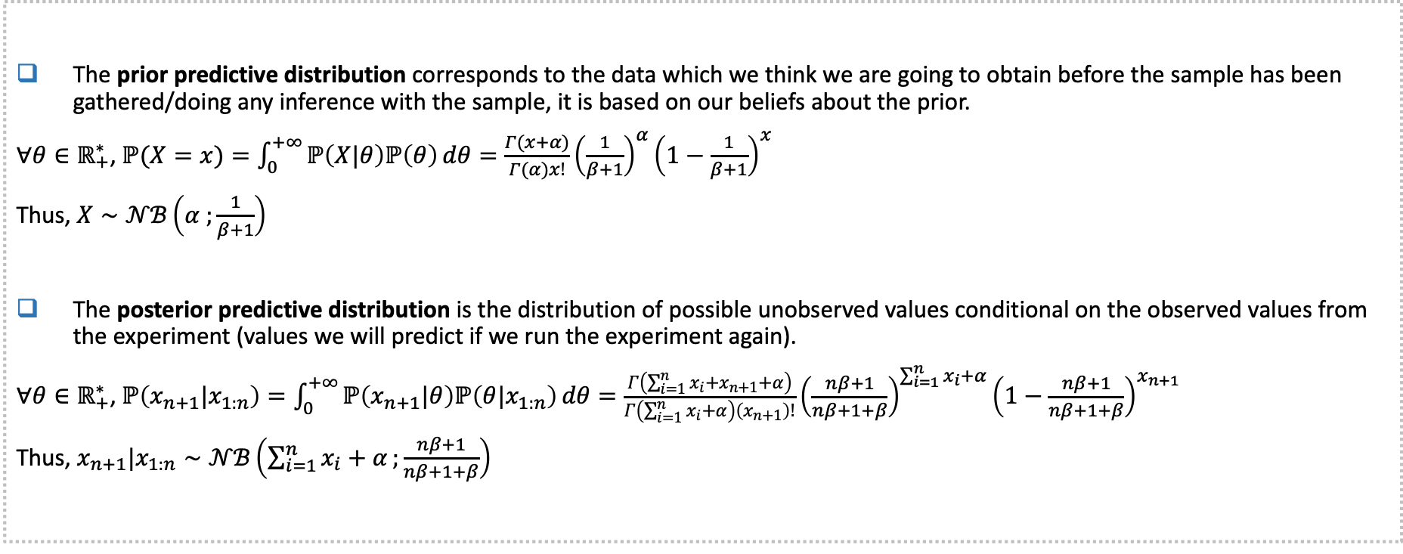
Prior & posterior predictive distributions (1/2)
The prior predictive distribution corresponds to the data which we think we are going to obtain before the sample has been gathered/doing any inference with the sample, it is based on our beliefs about the prior.
$∀θ∈ℝ_{+}^{∗}$, $ℙ(X=x)=\int_{0}^{+∞}{ℙ\left(X|θ\right)ℙ\left(θ\right)}dθ=\frac{Γ(x+α)}{Γ(α)x!}{\left(\frac{1}{β+1}\right)}^{α}{\left(1−\frac{1}{β+1}\right)}^{x}$
Thus, $X∼𝒩ℬ\left(α ;\frac{1}{β+1}\right)$
The posterior predictive distribution is the distribution of possible unobserved values conditional on the observed values from the experiment (values we will predict if we run the experiment again).
$∀θ∈ℝ_{+}^{∗}$, $ℙ\left(x_{n+1}|x_{1:n}\right)=\int_{0}^{+∞}{ℙ\left(x_{n+1}|θ\right)ℙ\left(θ|x_{1:n}\right)}dθ=\frac{Γ\left(\sum_{i=1}^{n}{x_{i}+x_{n+1}+α}\right)}{Γ\left(\sum_{i=1}^{n}{x_{i}+α}\right)\left(x_{n+1}\right)!}{\left(\frac{nβ+1}{nβ+1+β}\right)}^{\sum_{i=1}^{n}{x_{i}+α}}{\left(1−\frac{nβ+1}{nβ+1+β}\right)}^{x_{n+1}}$
Thus, $x_{n+1}|x_{1:n}∼𝒩ℬ\left(\sum_{i=1}^{n}{x_{i}+α};\frac{nβ+1}{nβ+1+β}\right)$

Slide 13
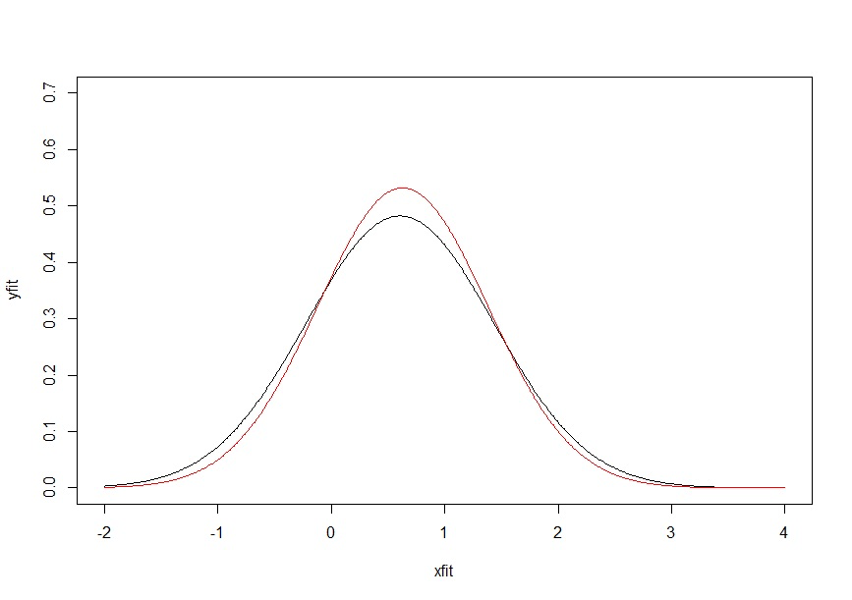
Prior & posterior predictive distributions (2/2)
For the weekly data we have drawn a sample from the prior predictive and the posterior predictive (respectively the red and the black curve)
The prior predictive is more or less accurate depending on the choice of the parameters but the posterior predictive gamma seems to be more accurate than the prior one.
The Gamma prior seems to be a good choice in case of a Poisson model when the a priori idea is true.
Prior predictive
Posterior predictive

Slide 14
Conclusion
In Bayesian statistics, the prior predictive distribution corresponds to the data which we think we are going to obtain before the sample has been gathered/doing any inference with the sample, it is based on our beliefs about the prior.
The posterior predictive distribution is the distribution of possible unobserved values conditional on the observed values from the experiment (values we will predict if we run the experiment again).
The objective of this project was to estimate the mean number of plane accidents in a given period of time by several methods :
The maximum likelihood
A uniform prior
A gamma prior
To compare those 3 methods we estimated the bias and the root mean square error of each estimator which are both measure of accuracy of an estimator.
The estimator derived from a gamma prior turned out to be the best estimator because it has the smallest bias and the smallest RMSE. The larger is the sample the better is the accuracy of the estimator.

